Slide 1
Object-Oriented Programming Using Java
Collections

Slide 2
Contents
Introduction to Collections
TreeSet
ArrayList
Sorting Algorithms
References: https://docs.oracle.com/javase/tutorial/collections/index.html

Slide 3
Introduction
A collection is simply an object that groups multiple elements into a single unit.
All collections frameworks contain the following
  Interfaces
  Implementations
  Algorithms

Slide 4
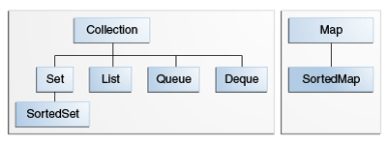
The core collection interfaces
Implementations
Set | HashSet |  | TreeSet |  | LinkedHashSet
List |  | ArrayList |  | LinkedList
Queue
Deque |  | ArrayDeque |  | LinkedList
Map | HashMap |  | TreeMap |  | LinkedHashMap

Slide 5
Implementations
Set — cannot contain duplicate elements.
  TreeSet: implementing the interface Set
    sorted according to the natural ordering of elements
List — can contain duplicate elements.
  ArrayList: implementing the interface List

Slide 6
Class java.util.ArrayList<E>
Return Type | Method and Description
boolean | add(E e) Appends the specified element to the end of this list.
void | add(int index, E element) Inserts the specified element at the specified position in this list.
void | clear() Removes all of the elements from this list.
Object | clone() Returns a shallow copy of this ArrayList instance.
boolean | contains(Object o) Returns true if this list contains the specified element.
E | get(int index) Returns the element at the specified position in this list.

Slide 7
Return Type | Method and Description
int | indexOf(Object o) Returns the index of the first occurrence of the specified element in this list, or -1 if this list does not contain the element.
boolean | isEmpty() Returns true if this list contains no elements.
iterator<E> | iterator() Returns an iterator over the elements in this list in proper sequence.
E | remove(int index) Removes the element at the specified position in this list.
boolean | remove(Object o) Removes the first occurrence of the specified element from this list, if it is present.
int | size() Returns the number of elements in this list.
void | sort(Comparator<? super E> c) Sorts this list according to the order induced by the specified Comparator.

Slide 8
Algorithms
Shuffling
Sorting
Finding Extreme Values
Searching
Routine Data Manipulation: reverse, copy, swap,…
Composition: frequency and disjoint
Notes:
frequency — counts the number of times the specified element occurs in the specified collection
disjoint — determines whether two Collections are disjoint; that is, whether they contain no elements in common

Slide 9
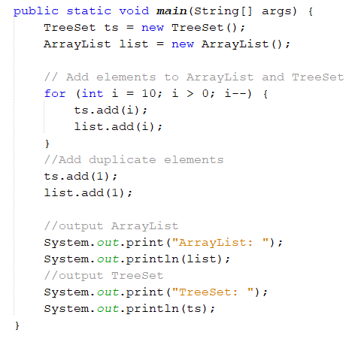
Example 1
ArrayList: [10, 9, 8, 7, 6, 5, 4, 3, 2, 1, 1]
TreeSet: [1, 2, 3, 4, 5, 6, 7, 8, 9, 10]

Slide 10
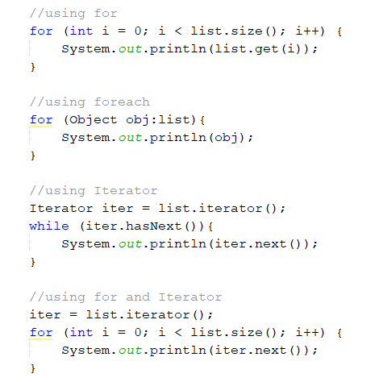
Iterate over the elements of a List

Slide 11
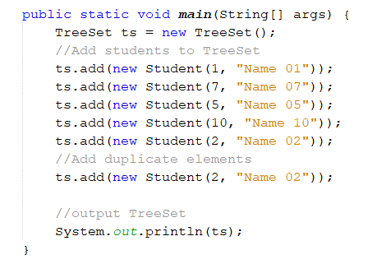
Example 2
Sorted according to id or name???
Run-time error

Slide 12
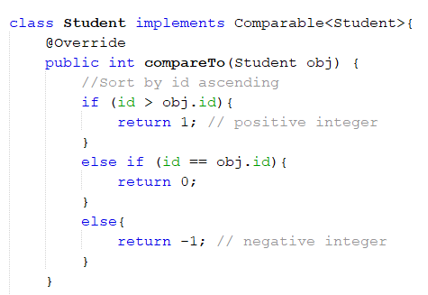
Comparable interface
public interface Comparable<T> {
public int compareTo(T o);
}
If the elements do not implement Comparable, Collections.sort(list) will throw a ClassCastException

Slide 13
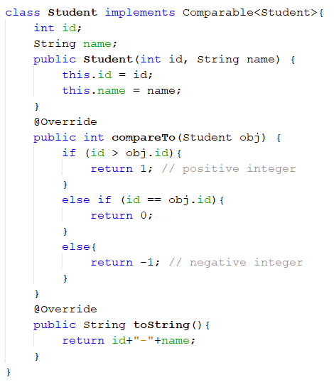
Implementing compareTo method
Example 2 output:

Slide 14
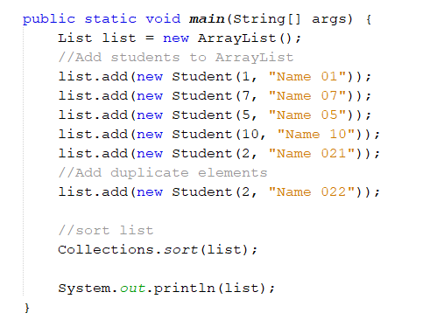
How to sort a list
Output: including duplicate elements

Slide 15
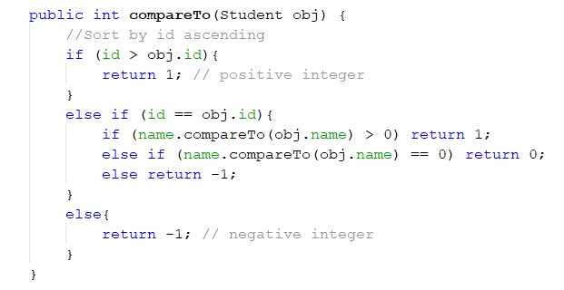

Example 3
Comparing 2 students based on ascending IDs then ascending Names

Slide 16
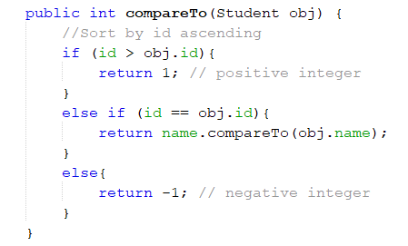
Example 3
Comparing 2 students based on ascending IDs then ascending Names

Slide 17
Comparator interface
public interface Comparator<T> {
public int compare(T o1, T o2);
}
param o1 the first object to be compared.
param o2 the second object to be compared.
return a positive integer (số nguyên dương): first argument is greater than the second.
return zero: first argument is equal to second.
return a negative integer (số nguyên âm): first argument is less than second.

Slide 18
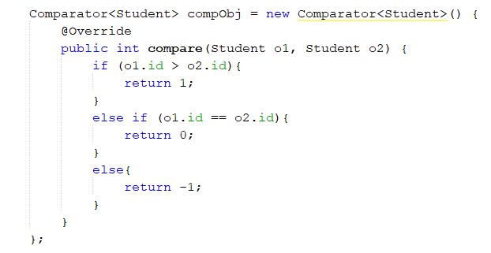

Sorting with Comparator Object

Slide 19
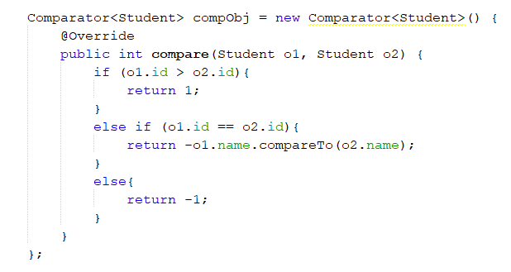
Example 4
Comparing 2 students based on ascending IDs then descending Names

Slide 20
Finding Extreme Values
Collections.min(list);
Collections.max(list);
→ returns the minimum (or maximum) element according to the elements' natural ordering.
Collections.min(list, comparator);
Collections.max(list, comparator);
→ returns the minimum (or maximum) element according to the specified Comparator.

Slide 21

Q&A

